Slide 1




Clinic Management System
Menna Ahmed
Menna Kamel
INSTRACTOR: DR/ Muhammed Elsayeh

Slide 2
Introduction
The Clinic Management System helps clinics work better.
It keeps track of departments, clinics, doctors, patients, and appointments.
It stores doctor and patient information and helps schedule appointments.
It keeps all records in one place using a relational database system.
The Clinic Management System makes clinic management easier.
.

Slide 3
Problem Description
The project is about creating a database system for managing clinics.
This system will help with scheduling appointments and storing patient information.
The clinic management system will manage doctors and different departments.
It will track appointment details such as diagnosis, appointment status, and cost.
The clinic management system is about making clinic management easier.

Slide 4
Entities and Attributes
Department
Dept_ID
Dept_Name
Clinic
Clinic_ID
Clinic_Name
Address
Dept_ID
Doctor
Doctor_ID
Doctor_Name
Phone_Number
Address
Specialization
Dept_ID
Patient
Patient_ID
Patient_Name
Phone_Number
Address
Birth_Date
Job
Appointment
Appointment_ID
Appointment_Date
Start_Time
End_Time
Cost
Status
Diagnosis
Patient_ID
Doctor_ID
.

Slide 5
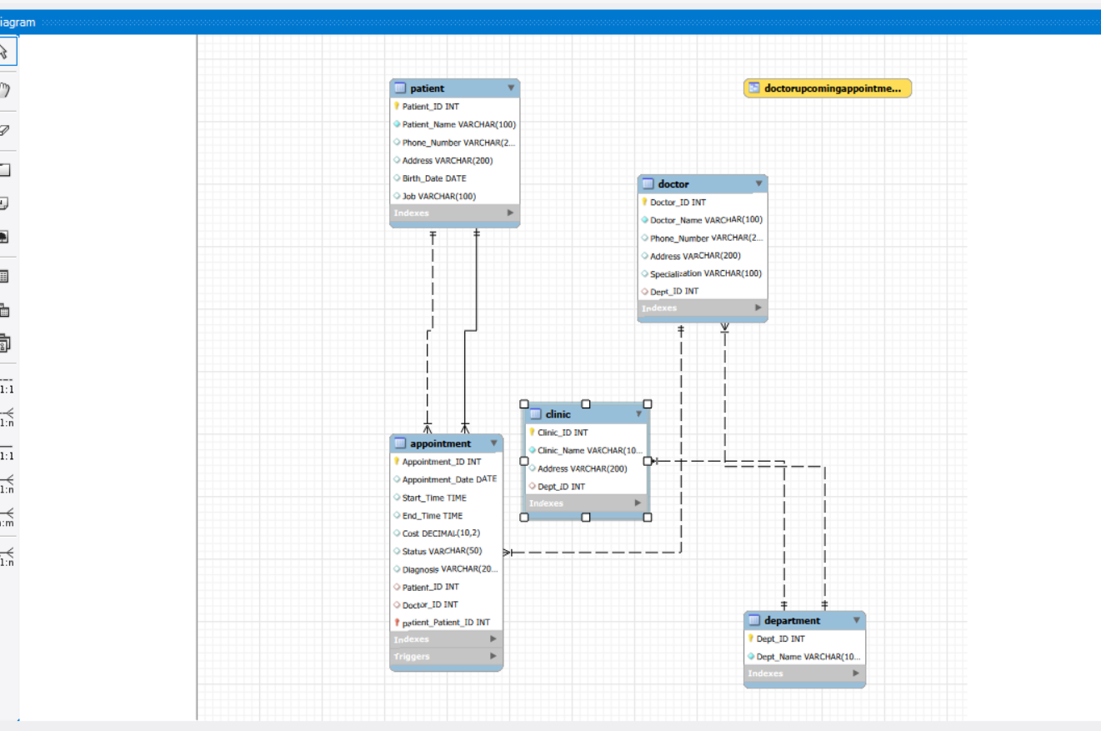
ER Diagram

Slide 6
Relationships
A Department can have multiple Doctors (1:M relationship).
A Clinic belongs to one Department (M:1 relationship).
A Doctor belongs to one Department (M:1 relationship).
A Doctor can have multiple Appointments (1:M relationship).
A Patient can have multiple Appointments (1:M relationship).
- Each Appointment is associated with one Doctor and one Patient (M:1 relationship).

Slide 7
SQL Implementation
The system was made using MySQL. This is what it does:
It creates tables
It puts data into these tables
It has views
It has triggers
It has queries
The system uses MySQL for all of this. It has a lot of features like tables creation and data insertion and views and triggers and queries, in MySQL.
.

Slide 8
conclusion
The Clinic Management System does a job of managing the clinic. It takes care of all the clinic operations. This includes the doctors, the patients and the appointments. The Clinic Management System uses a database system to do all of this. The Clinic Management System makes sure everything runs smoothly at the clinic from the doctors, to the patients and the appointments.

Slide 9
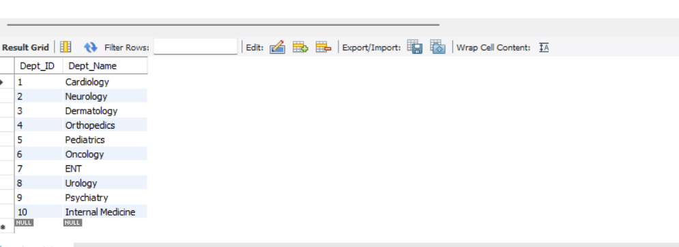
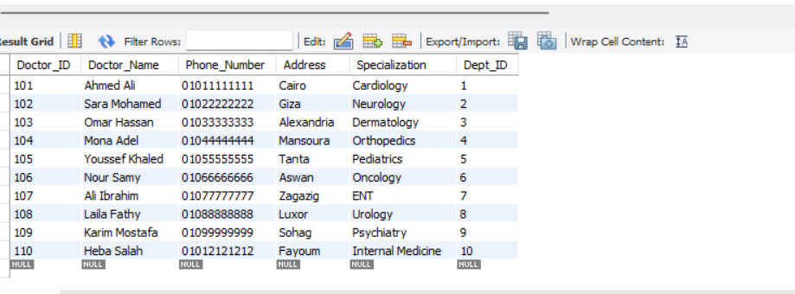
Department Table
Contains department details within the clinic, including department ID and department name.
Doctor Table
Stores doctor information including doctor ID, name, specialty, and department affiliation.

Slide 10
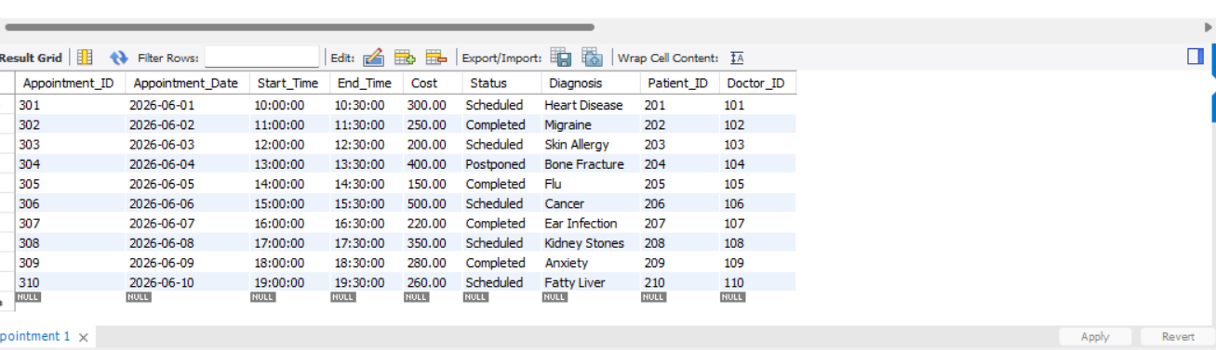
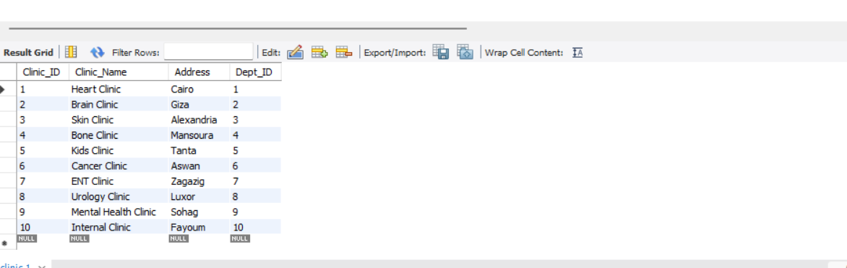
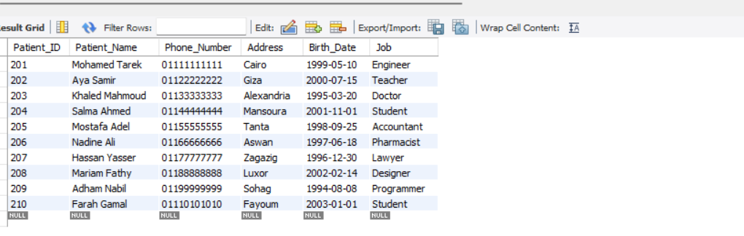
Appointment Table
Stores appointment information including date, time, cost, status, diagnosis, patient ID, and doctor ID.
Clinic Table
Stores clinic information such as clinic ID, clinic name, and location.
Patient Table
Contains patient records including patient ID, name, contact information, and personal details.

Slide 11
1. How would you prevent two appointments for the same doctor from overlapping?
I would create a trigger that checks if the doctor already has an appointment at the same time. If an overlap exists, the trigger prevents the insertion and displays an error message.
2. Describe a query to fetch each patient's appointments and diagnosis?
I would join the Patient and Appointment tables using Patient_ID and retrieve the patient's information, appointment details, and diagnosis.
3. You need a view showing each doctor’s upcoming appointment count for next month. What would its GROUP BY look like?
The view groups records by Doctor_ID and uses COUNT() to calculate the number of appointments for each doctor in the next month.

Slide 12
THANK
YOU

